Slide 1
Lecture 15:
Automated Test Case Generation
Gregory Gay
DIT636/DAT560 - March 10, 2025

Slide 2

Automating Test Creation
Testing is invaluable…
… but expensive.
We test for *many* purposes.
Near-infinite number of possible tests we could try.
Hard to achieve volume.
Notes:
We must produce reliable, robust software. Testing is invaluable in that quest. The downside, of course, is that testing is also very expensive especially since we test for *many* purposes, validating correctness, assessing performance, looking for security vulnerabilities, memory leaks, excessive battery usage, and so on. Any real-world piece of software with value has (3-4).

Slide 3

Automating Test Creation
Relieve cost by automating test creation.
Traditional Focus: Generate test input.
Just need to add assertions.
(Or measure crashes, performance, etc.)
New approaches have limited ability to generate test oracles.
Automation!
Tests are generating!
Notes:
However, we live in the age of automation - of AI, of big data and deep learning, and all of that. Can’t we do something about this? This cost, the tremendous amount of manual, fallable human effort going into testing, could be relieved by automating part, at least, of the creation process. Over the past several decades, there have been a number of approaches that can do just that, with the majority of traditional approches focused on generating test input. The algorithm can create test cases with input for us, and then we just need to add test oracles. Or, in many cases, we just want to see crashes or exceptions - then we don’t need human help at all - fuzzers, for instance, can very effectively find crashes, overflows, and other security vulnerabilities without human intervention. Now, especially with LLMs and other machine learning appraoaches, we are also starting to see the ability to generate test oracles too, though sometimes those oracles are irrelevant, trivial, or incorrect - so there is still progress to be made there.

Slide 4
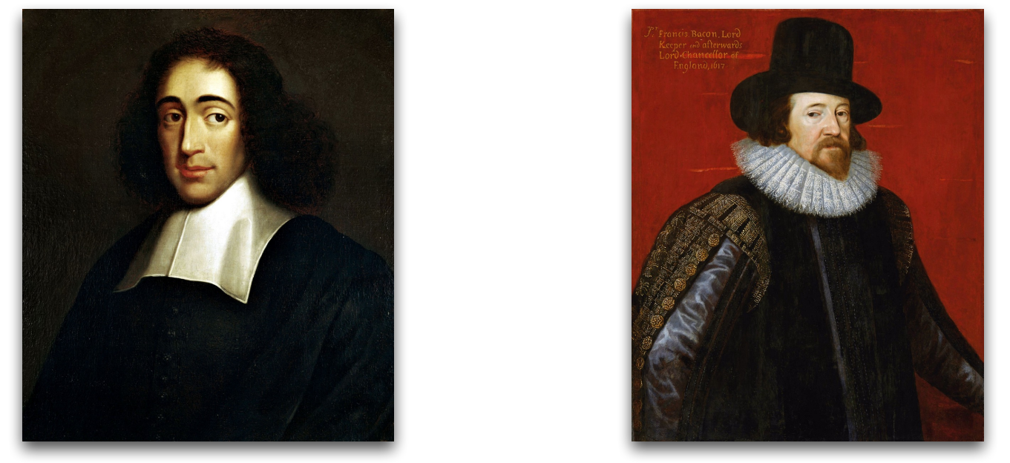
Techniques for Generating Tests
Rationalists (Static)
Empiricists (Dynamic)
Generate tests based on analysis of the source code and other text.
Generate tests based on feedback from executing the system.
Notes:
Today, we’re going to discuss two particularly important forms of automated test generation. These are brought to us by our old friends, the rationalists and the empiricists. As you may recall, the rationalists tend to argue for static approaches based on analysis of the source code, while the empiricicsts argue for dynamic approaches based on executing the system. We will first talk about the empiricist side, focused on a technique called search-based test generation. This is an approach where tests are created, executed, then evolved based on feedback from that execution. We will spend the most time here because this is something you could code up yourself and adapt to whatever problem you want to solve or whatever task you want to automate - it is a very flexible approach to automating many development tasks. We will then turn to the rationalist- the static - side and discuss large language models, which can generate tests based on the textual information presented about the system-under-test.

Slide 5
Today’s Goals
Search-Based Test Generation
Test creation as an optimization problem, based on feedback from executing the code.
Generate -> Execute -> Evolve
LLM-Based Test Generation
Test creation based on textual analysis.

Slide 6
Search-Based Test Generation

Slide 7
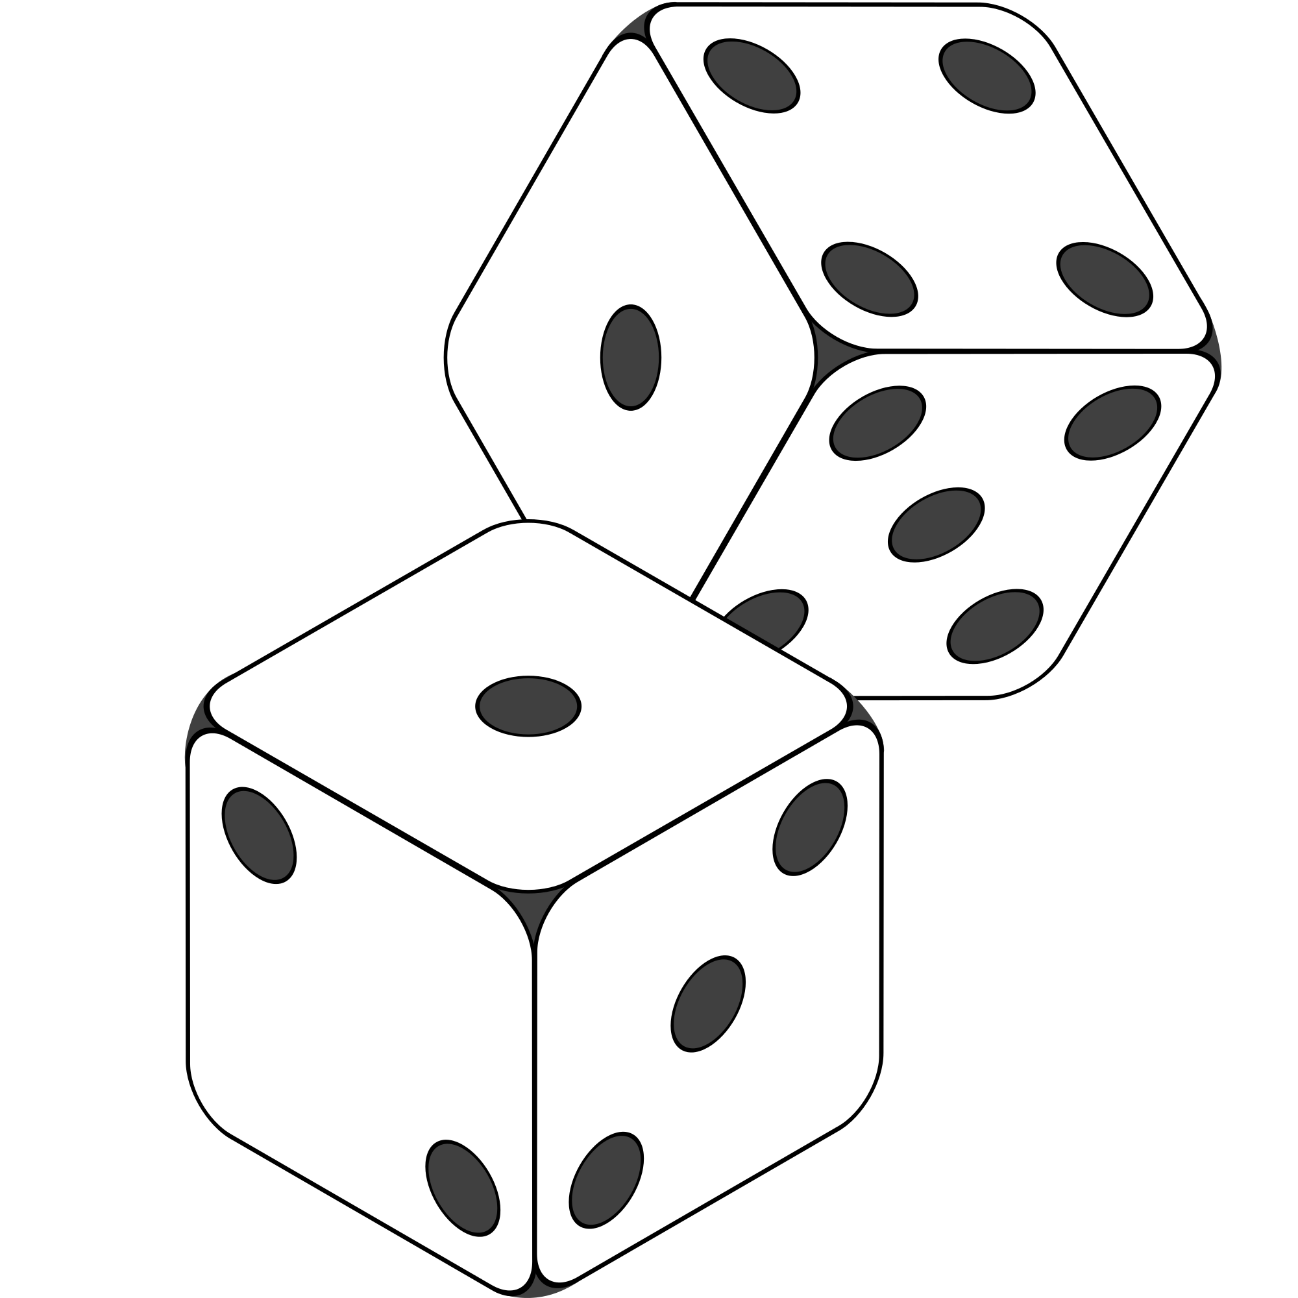
Random Generation
Randomly formulate test cases.
Unit testing: choose a class in the system, choose random methods, call with random parameter values.
System-level testing: choose an interface, choose random functions from interface, call with random values.
Keep trying until goal attained or you run out of time.
Notes:
Before we get into the full techniques, let’s start simple, and the simplest form of test generation is purely random generation, which is where we (1) If we’re unit testing, choose a class in the system. Generate a series of method calls to that class. Random number of calls, range 1-(max test case size). Methods to call chosen randomly from list of methods. Method parameters generated randomly. Random integer, random string, etc. Run those tests, see if they meet your goals. If system-level tests, we’re looking at a similar strategy. Generate a series of calls to an API, CLI, or GUI up to a set max test size. Set the parameters of those randomly. Run them and see what happens. You get the point. Generate a set of test cases completely at random, try them. If it doesn’t meet whatever goal you have - say finding crashes - try another solution. Keep trying until the goal is attained or budget expires. Pretty straightforward. Let’s take a closer look at what that might look like, since this is a major building block of where we will end up.

Slide 8
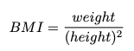
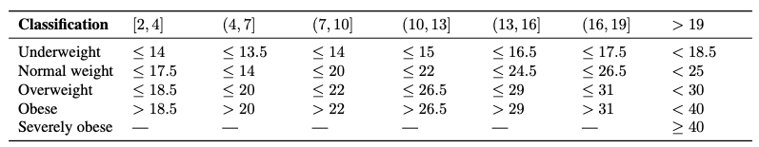
Example - BMI Calculation
BMICalc
height
weight
age
bmi_value()
classify_bmi_adults()
classify_bmi_teens_and_children()
Age
Notes:
We can illustrate concepts related to automated test generation using a class that implements different variants of a body mass index (BMI) classification . BMI is a value obtained from a person’s weight and height to classify them as underweight, normal weight, overweight, or obese. There are two core parts to the BMI implementation: (i) the BMI value, and (ii) the BMI classification. The BMI value is calculated as weight/height^2 using height in meters (m) and weight in kilos (kg). In turn, the BMI classification uses the BMI value to classify individuals based on different threshold values that vary based on the person’s age and gender. The BMI thresholds for children and teenagers vary across different age ranges (e.g., from 4 to 19 years old). As a result, the branching options quickly expand.The BMI classification is particularly interesting case for testing because, (i), it has numerous branching statements based on multiple input arguments (age, height, weight, etc.), and (ii), it requires testers to think of specific combinations of all arguments to yield BMI values able to cover all possible classifications. (point to table). the BMICalc class we are testing has three variables: age, height, and weight. Then, there are methods we can call to get the BMI value and then two methods for BMI classification - one for adults and one for children/teens.

Slide 9
Example - BMI Calculation
def test_bmi_value_valid():
bmi_calc = BMICalc(150, 41, 18)
bmi_value = bmi_calc.bmi_value()
assert bmi_value == 18.2
def test_bmi_adult():
bmi_calc = BMICalc(160, 65, 21)
bmi_class = bmi_calc.classify_bmi_adults()
assert bmi_class == "Overweight"
def test_bmi_children_4y():
bmi_calc = BMICalc(100, 13, 4)
bmi_class = bmi_calc.classify_bmi_teens_and_children()
assert bmi_class == "Underweight"
BMICalc
height
weight
age
bmi_value()
classify_bmi_adults()
classify_bmi_teens_and_children()
Notes:
Here are three unit tests we might write for this class, written in the Python pytest unit testing framework. The first is a test of the BMI value calculation. We set up the class with a height of 150 cm, weight of 41 kg, and an age of 18. We get the value, and we check that it is what we would expect, which is 18.2. In the second, we check the classification of an adult - a 21 year old with 160 cm height and 65 kg weight, we call the classification method for adults, and we assert that the resulting classification is overweight. The third is similar, for a 4 year old child who is 100 cm tall and 13 kg, who we expect to be underweight.

Slide 10
Random Generation - BMI Example
Create an empty test case:
def test_1():
Instantiate the class-under-test with random values:
def test_1(): cut = BMICalc(180, 50, 40)
Insert 1+ method calls or assignments to class variables.
Number of calls is random
Which method/variable is random
Method parameters are random values
BMICalc
height
weight
age
bmi_value()
classify_bmi_adults()
classify_bmi_teens_and_children()
def test_1(): cut = BMICalc(180, 50, 40) output = cut.bmi_value() cut.height = 15681 output2 = cut.classify_bmi_adults()
Notes:
Now, to generate random unit tests for this, we might first create an empty test case with a unique name. Then, we would instantiate the class-under-test by generating random values for the constructor. Then, we would generate one or more method calls to any of the available methods. All aspects of this selection are random (last three points). So, a test case might look like this. And this would be a weird test case, as we suddenly changed the height to 15681. This person would be pretty underweight at that height.

Slide 11
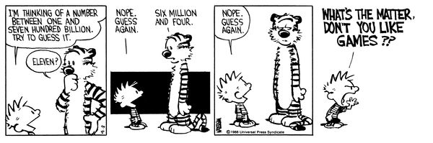
Random Search
Sometime viable:
Extremely fast.
Easy to implement, easy to understand.
All inputs considered equal, so no designer bias.
However…
Notes:
Random search is actually a somewhat common method of automatically generating test inputs. (1) There is no overhead, no complex planning, just pick and try. Nothing beats it on pure speed per guess. It’s easy to understand, easy to implement. All inputs considered equal, so no designer bias. It is absolutely a viable method of testing some systems, especially if you’re just looking for crashes - just spam that system with input. If you can try 10000 things in 5 minutes, you might stumble on a fault. However… (comic). The challenge with purely random test generation is that most systems have a near-infinite number of possible test cases, especially when we look at not just one call but a series of method calls. We can’t try everything, and there is no information to help us come up with good test cases. We need something a little smarter, which is where the concept of search-based test generation comes into the picture.

Slide 12
Test Creation as a Search Problem
Do you have a goal in mind when testing?
Make the program crash, achieve code coverage, find performance bottlenecks, …
Searching for a test suite that achieves that goal.
Based on guess-and-check process.
Notes:
Test input selection can naturally be seen as a search problem. When you create test cases, you often have one or more goals. Perhaps that goal is to find violations of a specification, to assess performance, to achieve code coverage, or any number of other things that we may have in mind when we design test cases. We cannot try all input. However, somewhere in that space of possibilities lies a subset of inputs that best meets the goals we have in mind. Out of all of the test cases that could be generated, we want to identify—systematically and at a reasonable cost—those that best meet those goals. Search-based test generation is an intuitive AI technique for locating those test cases that maps to the same process we might use ourselves to find a solution to a problem. Let us consider a situation where you are asked a question. If you do not know the answer, you might make a guess—either be an educated guess or one made completely at random. In either case, you would then get some feedback. How close were you to reaching the “correct” answer? If your answer was not correct, you could then make a second guess. Your second guess, if nothing else, should be closer to being correct based on the knowledge gained from the feedback on that initial guess. If you are still not correct, you might then make a third, fourth, etc. guess—each time incorporating feedback on the previous guess.

Slide 13
Test Creation as a Search Problem
Many testing goals can be measured:
How many exceptions were thrown?
How fast was the code?
What percentage of lines of code were covered?
How diverse is our input?
If goal can be measured, search can be automated.
Notes:
Test input generation can be mapped to the same process. We start with a problem we want to solve. We have some goal that we want to achieve through the creation of unit tests. If that goal can be measured, then we can automate input generation. Fortunately, many testing goals can be measured. • If we are interested in exploring the exceptions a class can throw, then we want the inputs that trigger the most exceptions. • If we are interested in covering all outcomes of a function, then we can divide the output into representative values and identify the inputs that cover all representative output values. • If we are interested in executing all lines of code, then we are searching for the inputs that cover more of the code structure. • If we are interested in executing a wide variety of input, then we want to find a set of inputs with the highest diversity in their values. Attainment of many goals can be measured, whether as a percentage of a known checklist or just a count that we want to maximize. Even if we have a higher-level goal in mind that cannot be directly measured, there may be measurable sub-goals that correlate with that higher-level goal. For example, “find faults” cannot be measured—we do not know what faults are in our goal—but maximizing code coverage or covering diverse outputs may increase the likelihood of detecting a fault. Once we have a measurable goal, we can automate the guess-and-check process outlined above via a metaheuristic optimization algorithm.

Slide 14

Search-Based Test Generation
Make one or more guesses.
Generate one or more individual test cases or full test suites.
Check whether goal is met.
Score each guess.
Try until time runs out.
Alter the solution based on feedback and try again!
Notes:
The rough idea of a search process is that you (1-2). (3) Score each solution based on their attainment of the overall goals. Then (5) Alter the population of guesses based on our search stragegy- our metaheuristic and potentially feedback from those scores - and try again.

Slide 15
Search Strategy
The order that solutions are tried is the key to efficiently finding a solution.
A search follows some defined strategy.
Called a “metaheuristic”.
Metaheuristics are used to choose solutions and to ignore solutions known to be unviable.
Smarter than pure random guessing!
Notes:
Given that near-infinite number of possible inputs, (1). We want to spend the shortest time we can to find a solution that meets our goals. As a result, all search techniques follow a defined strategy, the search heuristic. (4)
If other solutions share properties with candidates already tried that rule them out as candidates, you can choose to ignore them in favor of other candidates. Metaheuristics determine the order that we explore the search space. (last point)

Slide 16
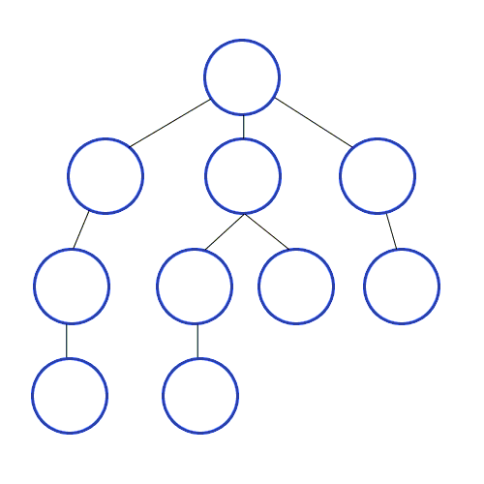
Heuristics - Graph Search
Arrange nodes into a hierarchy.
Breadth-first search looks at all nodes on the same level.
Depth-first search drops down hierarchy until backtracking must occur.
Attempt to estimate shortest path.
A* search examines distance traveled and estimates optimal next step.
Requires domain-specific scoring function.
Notes:
To give you an idea of the range of heuristics available to solve problems, let’s look at a problem domain you might be familiar with already. You’ve all taken some kind of algorithms or data strcutures course. Then you probably talked about graphs. Given a directed acyclic graph, we might want to find a particular node of interst, and we aren’t sure where it is. One family of heuristics arranges nodes into a hierarchy and explores them. Breadth-first search explores a graph by trying all nodes one level deeper than the current node. Depth-first search jumps checks a node, and if it has a child, jumps to it - not looking at other nodes on the same level until backtracking must occur. Other strategies attempt to estimate the shortest path using a cost function - incorporating domain-based knowledge. A* search finds a path through a graph by calculating the distance travelled so far and examining all “next moves” and estimating which will get them closest to the goal (last) but if you choose a good scoring function, you can get to a solution much faster than when you just try to explore everything. A* is useful approach for things like robot pathfinding - hills are harder to climb than flat ground, so you can steer around them and get to a goal with more battery life left or at a faster speed. From this, you can see a range of different heuristics. Some are faster than others, some are easier to understand and implement. Some require deep knowledge and understanding, others will work well without this understanding. Likewise, in search-based test generation, there are different heuristics we can use to sample the input space. Some are more complex than others, some work better for specific problems.

Slide 17
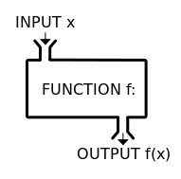


Search-Based Test Generation
+
=
The Metaheuristic
(Sampling Strategy)
Genetic Algorithm
Simulated Annealing
Hill Climber
(...)
The Fitness Functions
(Feedback Strategies)
Distance to Coverage Goals
Count of Executions Thrown
Input or Output Diversity
(...)
(Goals)
Cause Crashes
Cover Code Structure, Generate Covering Array,
(...)
Notes:
Search-based test generation is more similar to something like A*, where we incorporate some domain expertise on what we are looking for. This process is powered by metaheuristic optimization algorithms which define how we select and modify test cases. The metaheuristic is guided by feedback from one or more fintess functions. scoring mechanisms that tells you good a proposed solution is. How close is it to meeting our goals? The metaheuristic takes feedback from the Testing has one of more goals, such as executing certain code elelements, driving the system to throw exceptions, detecting planted faults. The fitness functions offer feedback, based on those goals, to shape the test suites, ideally in a way that brings us closer to our goals.

Slide 18
Solution Representation
Must decide what a solution “looks like”.
For unit testing:
A solution is a test suite.
A test suite contains 1+ test cases.
Each test case interacts with a class-under-test.
Each test case initialized the class-under-test.
Each test case contains one or more actions.
An action is a method call or variable assignment.
Each action has parameters (method parameters or values to assign to variables).
Notes:
When solving any problem, we first must define the form the solution to the problem must take. What, exactly, does a solution to a problem “look” like? What are its contents? How can it be manipulated? Answering these questions is
crucial before we can define how to identify the “best” solution. In this case, we might be interested in identifying a set of unit tests that maximise attainment of a testing goal. This means that a solution is a test suite—a collection of test cases. We can start from this decision, and break it down into theelements relevant to our problem. • A solution is a test suite. • A test suite contains one or more test cases, expressed as individual methods of a single test class. • The solution interacts with a unit-under-test (UUT) which is a single, identified class with a constructor (optional) and one or more methods. • Each test case contains an initialization of the CUT which is a call to its constructor, if it has one. • Each test case then contains one or more actions, i.e., calls to one of the methods of the CUT or assignments to a class variable. • The initialization and each action have zero or more parameters (input) supplied to that action.
This means that we can think of a test suite as a collection of test cases, and each test case as a single initialization and a collection of actions, with associated parameters. When we generate a solution, we choose a number of test cases to create. For each of those test cases, we choose a number of actions to generate. Different solutions can differ in size—they can have differing numbers of test cases—and each test case can differ in size—each can contain a differing number of actions

Slide 19
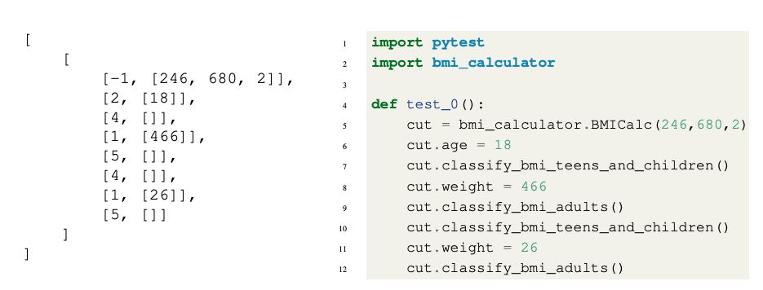
External vs Internal Representation
Internal (Genotype) Representation
Can be easily manipulated by metaheuristic
External (Phenotype) Representation
Executable, human-readable
Test Suite
Test Case
Actions, with ID (method or variable), parameters
Notes:
In search-based test generation, we represent two solutions in two different forms: Phenotype (External) Representation: The phenotype is the version of the solution that will be presented to an external audience. This is typically in a human-readable form for a test case. What we have on the right here on the slide. The phenotype representation takes the form of an executable test class. In turn, each test case is a method containing an initialization, followed by a series of method calls or assignments to class variables, as we discussed. This can be run directly and read by humans. • Genotype (Internal) Representation: The genotype is a representation used internally, within the metaheuristic algorithm. This version includes the properties of the solution that are relevant to the search algorithm, e.g., the elements that can be manipulated directly. It is generally a minimal representation that can be easily manipulated by a program. The external representation is not ideal for use by the metaheuristic search algorithm as it cannot be easily manipulated. If we wanted to change one method call to another, we would have to identify which methods were being called. If we wanted to change the value assigned to a variable, we would have to identify (a) which variable was being assigned a value, (b) identify the portion of the line that represents the value, and (c), change that value to another. Internally, we require a representation that can be manipulated quickly and easily. This is on the left. A test suite is a list of test cases. If we want to add a test case, we can simply append it to the list. If we want to access or delete an existing test case,
we can simply select an index from the list. Each test case is a list of actions. Similarly, we can simply refer to the index of an action of interest. Each action is a list containing (a) an action identifier - referring to a specific method call or variable that we can assign values to- and (b), a list of parameters to that action. An identifier of −1 is reserved for the constructor

Slide 20
Fitness Functions
Domain-based scoring functions that determine how good a potential solution is.
Should represent goals of tester.
Must return a numeric score.
% of a checklist
raw number
NOT Boolean (no feedback)
Can be maximized or minimized.
Notes:
As previously-mentioned, fitness functions are the cornerstone of search-based test generation. The core concept is simple and flexible—a fitness function is simply a function that takes in a solution candidate and returns a “score” describing the quality of that solution. This gives us the means to differentiate one solution from another, and more importantly, to tell if one solution is better than another. Fitness functions are meant to embody the goals of the tester. They tell us how close a test suite came to meeting those goals. The fitness functions employed determine what properties the final solution produced by the algorithm will have, and shape the evolution of those solutions by providing a target for optimization.
Essentially any function can serve as a fitness function, as long as it returns a numeric score. It is common to use a function that emits either a percentage (e.g., percentage of a checklist completed) or a raw number as a score, then either maximise or minimise that score. A fitness function should not return a Boolean value. This offers almost no feedback to improve the solution.

Slide 21
Fitness Functions
Should offer feedback:
Small change in solution should not lead to large change in score.
Best functions calculate distance to optimality.
Can optimize more than one at once.
Independently optimize functions
Combine into single score.
Notes:
A fitness function should yield (largely) continuous scores. A small change in a solution should not cause a large change (either positive or negative) in the resulting score. Continuity in the scoring offers clearer feedback to the metaheuristic algorithm. • The best fitness functions offer not just an indication of quality, but a distance to the optimal quality. For example, rather than measuring completion of a checklist of items, we might offer some indication of how close a solution came to completing the remaining items on that checklist. We’ll show an example of that in a second. Depending on the algorithm employed, either a single fitness function or multiple fitness functions can be optimised at once. If multiple are optimized, all functions will shape the final test suite, so this is often a nice way to get versatile tests. We can optimize multiple fintness functions in two ways. we can either try to balance multiple functions, finding solutions that improve all scores for all functions as much as possible without hurting the scores of other functions. This is very effective, but can be very difficutl. The second thing is that we can create a single combined score as a linear combination of scores of the individual functions. This is easier and often works well, but allows maximization of one function at the expense of others.

Slide 22
Example - Code Coverage
Goal: Attain Branch Coverage over the code.
Tests must reach all branching points (i.e., if-statement) and execute all possible outcomes.
if(x < 10){
// Do something.
}else if (x == 10){
// Do something else.
}
In this code:
Two Branches
Each must evaluate to true and false.
Notes:
So, to give an example, let’s take a code coverage measurement called branch coverage. When we measure branch coverage, we look at the decision points in a program - if statements, loop statements - for, while, foreach, etc, switch statements, and ensure that we try the different outcomes - true and false for if-statements and loop conditions, the different cases for a switch. The idea is that tests that cover the different outcomes of these statements will do a good job of thoroughly touching each line of code, making those tests more likely to expose bugs. This is often used to decide when you’re done testing - did you cover every branch outcome? In this little bit of code, we have two branching points. We want each to evaluate to false and each to evaluate to true when we execute our test cases. If all of these branching pioints evaluate to all possible outcomes, we achieve branch coverage.

Slide 23
Example - Code Coverage
Goal: Attain Branch Coverage over the code.
Fitness function (Basic):
Measure coverage and try to maximize % covered.
Good: Measurable indicator of progress. Can use standard tools (pytest-cov, Cobertura).
Bad: No information on how to improve coverage.
Notes:
Branch coverage is a good goal for test generation, as we can measure it without a human present. This means we can try to optimize it. Now, how would you design a fitness function for it? Well, as a first attempt, we could just measure coverage and try to maximize that percentage. There are standard tools to perform this calculation, like pytest-cov in Python or in Java, we can use Cobertura or IntelliJ has built-in tools that can measure this. This can be very effective as a fitness function. However, it’s main weakness is that it only tells us what we have covered. This dopes not tell us much about how to improve solutions. We can tell how good any one solution is, but have to way to compare two solutions with equal coverage to see which could be improved more easily. Instead - what we want to know is whether we can we score a test such that we can learn from the attempt? Not just “is this good”, but “how close is this to being THE BEST”. That leads to an even better fitness function.

Slide 24
Example - Code Coverage
Advanced: Distance-Based Function
fitness = branch distance + approach level
Approach level
Number of branching points we need to execute to get to the target branching point.
Branch distance
If other outcome is taken, how “close” was the target outcome?
How much do we need to change program values to get the outcome we wanted?
Notes:
So, generally, we don’t directly use branch coverage as the fitness function. Instead, a common fitness function for branch coverage is to target a single branch and outcome at a time, execute a test, and calculate two things - called the branch distance and approach level. The approach level is defined as the count of the target branch's control-dependent predecessors that have not been executed---that means the earlier branches in the code that we need to pass through to get to this point - how many if-statements, loops statements, and switches need to execute in the manner we desire to get to THIS branch. It is essentially a directional indicator. It gets lower as the execution path gets closer to the target branch.
now, if we reach the right line of code where the target branch exists, but get the wrong outcome - say true when we wanted false - the branch distance kicks in. Branch distance is computed from the point where the execution path diverged from the targeted branch. If an undesired outcome is taken, branch distance describes how ``close'' we were to the outcome we wanted, using a cost function based on the formula of that statement. (last point) Let’s look at an example of this.

Slide 25
Example - Branch Coverage
if(x < 10){ // Branch 1
// Do something.
}else if (x == 10){ // Branch 2
// Do something else.
}
Approach Level
If Branch 1 is true, approach level = 1
If Branch 1 is false, approach level = 0
Branch Distance
If x==10 evaluates to false, branch distance = (abs(x-10)+k).
Closer x is to 10, closer the branch distance.
Goal: Branch 2, True Outcome
Notes:
Suppose that the current goal is to execute the \texttt{true} outcome of branching point 2. If branching point 1 is reached and evaluates to \texttt{true}, then the approach level is 1. We are one branching point away from our target. If, instead, \texttt{x == 10} - branching point 2 - is reached, then the approach level is 0, as the target branching point has been reached. If \texttt{x == 10} evaluates to \texttt{false}, then we didn’t get the outcome we wanted. In that case, we check branch distance using the formula \texttt{abs(x-10) + k}, where k is a small constant. The closer \texttt{x} is to 10, the closer the targeted outcome was to being hit. We get the exact formula based on the contents of the if-statement, but the general idea is the same. this gives us some information to work with. We know how close a test is to giving the outcome we wanted, and this arms the search with the ability to get a little bit closer each time to hitting that outcome. If two solutions give us the same total branch coverage, we can favor the one that gets us closer to covering the remaining branches - that have the smallest approach level and branch distance.

Slide 26
Other Common Fitness Functions
Number of methods called by test suite
Number of crashes or exceptions thrown
Diversity of input or output
Detection of planted faults
Amount of energy consumed
Amount of data downloaded/uploaded
… (anything that reflects what a good test is)
Notes:
(go over). Great thing is the flexibility of this method. Fitness functions shape a test suite, based on what you feel is a good test suite. Anything that can be measured efficiently can be used as a fitness function. And, you often choose a couple of these and try to optimize them all at once, shaping an effective test suite.

Slide 27
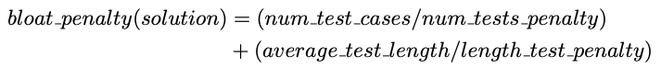
Bloat Penalty
Small penalty subtracted from fitness.
Limits number of tests and number of actions.
Important not to penalize too heavily.
ex. 10
ex. 30
Notes:
When calculating fitness, we often incorporate small additional properties related to what results in a good test suite. A very common thing to do is to subtract from the fitness score a bloat penalty. The bloat penalty is a small penaltintended to control the size of the produced solution in two dimensions: the number of test cases, and the number of actions in each test. A massive test suite may attain high code coverage, but it is likely to contain many redundant elements as well. In addition, it will be more difficult to understand when read by a human. In particular, long sequences of actions may hinder efforts to debug the code and identify a fault. Therefore, we use the bloat penalty to encourage the metaheuristic algorithm to produce small-but-effective test suites. The bloat penalty is calculated as follows: (num test cases/num tests penalty) + (average test length/length test penalty). The penalties are weighrts that a tester can adjust, for example
num tests penalty is 10 and length test penalty is 30. That is, we divide the number of test cases by 10 and the average length of a single test case (number of actions) by 30. It is important to not penalise too heavily, as that will increase
the difficulty of the core optimization task—some expansion in the number of tests or length of a test is needed to cover the branching structure of the code. These penalty values allow some exploration while still encouraging the
metaheuristic to locate smaller solutions.

Slide 28
The Metaheuristic
Decides how to select and revise solutions.
Changes approach based on past guesses.
Fitness functions give feedback.
Population mechanisms choose new solutions and determine how solutions evolve.
Notes:
We need to choose a smart strategy to sample from the search space. The metaheuristic decides how to select and revise solutions and Changes its approach based on past guesses by trying to learn something about what we just tried. The metaheuristic makes a purely random guess on the first attempt, then gets feedback from the fitness functions - often not just whether or not it was a good test, but how close it was to being the best test. The algorithm and fitness function form a symbiotic relationship where the algorithm tries a solution, finds out whether it meets our goals, then uses its score in conjunction with a set of population manipulation mechanisms to generate new solutions and iterate on the best solutions.

Slide 29
The Metaheuristic
Decides how to select and revise solutions.
Small changes to single solution (local search).
Large changes to many solutions (global search).
Often based on natural phenomena.
(swarm behavior, evolution)
Trade-off between speed, complexity, and understandability.
Notes:
There are two main families of metaheuristics, local searches - which tend to focus on a single solution at a time and make small adjustments. global searches focus on multiple solutions and tend to make larger changes to them.
The core strategies used by many of these are based on (3). In any case, the choice of metaheuristic is a (4). Some are very fast, but vulnerable to getting trapped when a bad guess is made. Some are better for certain problems. Some are very complex and will give you a better solution, but require a substantial time investment. There are a number of trade-offs to consider. We will present two here - a simple hill climber, then a more complex genetic algorithm - which is slower, but potentially produces more robust solutions.

Slide 30
How Long Do We Spend Searching?
Exhaustive search not viable.
Search can be bound by a search budget.
Number of guesses.
Time allotted to the search (number of minutes/seconds).
Optimization problem:
Best solution possible before running out of budget.
Notes:
We place an end point on the search using our search budget. This can come in two forms. Either the number of attempts made. Or the total time allocated to the search, in minutes, seconds. We will allow two minutes to come up with something. Without an exhaustive search, we can make no guarantees about finding the best possible solution. We can’t ensure the goal is met, we can’t ensure it can be met, and we can’t promise the most optimal solution. What we try to do is choose a metaheuristic that delivers the best solution possible before we run out of time or guesses.

Slide 31
Local Search
Generate and score a single potential solution.
Attempt to improve by looking at its neighborhood.
Make small, incremental improvements.
Very fast, efficient if good initial guess.
Get “stuck” if bad guess.
Often include reset strategies.
Notes:
Local searches tend to be pretty simple (1). In local search, this is generally one solution at a time, while in globalb searches, we often evolve a population of solutions in parallel. Then, (2). The neighbors are any test cases that could be generated by making a small incremental change to the current solution. The idea is that, if you’re pretty good already, you might improve by making a tiny, tiny change. If you do, try to improve again, and keep going until you can’t get any better. Local searches tend to be very easy to implement and are very fast to execute as long as you picked a good starting point. That’s the big issue, though. If you didn’t make a good initial guess, you can get stuck in a particular region of the solution space, unable to find a good solution. The basic thing that you can do to help with this is to add restarts when you get stuck.

Slide 32
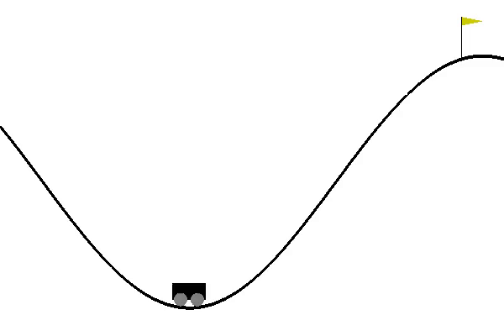
Hill Climbing
Generate a random initial solution.
Each generation (while budget remains):
Attempt up to max_tries mutations to the solution.
If a mutation results in a better solution, set this as the new solution.
Keep track of the best mutation seen to date.
If we run out of tries, reset to a new random initial solution.
Notes:
The basic form of local search is called hill climbing. A Hill Climber is a classic metaheuristic that embodies the “guess-and-check” process we discussed earlier. The algorithm makes an initial guess purely at random, then attempts to improve that guess by making small, iterative changes to it. While we still have search budget remaining, we attempt to improve this solution over a series of generations of evolution. Each generation, we get a set number of attempts to improve the solution. We impose a mutation to the current solution - a small change. If that change results in a better score, we adopt the mutated solution as our new solution and continue to the next generation - keeping track all along iof the best solution we have ever seen. If we run our of tries, we restart with a new completely random solution. We can think of the landscape of possible solutions as a topographical map, where better fitness scores represent higher levels of elevation in the landscape. This algorithm is called a “Hill Climber” because it attempts to scale that landscape, finding the tallest peak that it can in its local neighborhood. At times, we reach a point where we can’t improve the fitness any further. We refer to these situations at local optima. If we reach a local optima, we need to move to a new “neighborhood” in order to find taller peaks to ascend. At the end, you return the best solution you saw during that run.

Slide 33
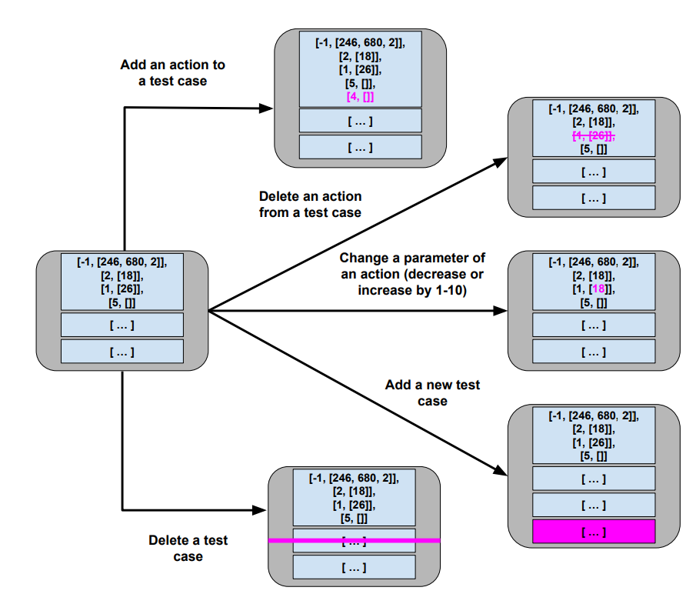
Mutation
Small change to current solution.
Impose one of these changes at a time:
Notes:
Each generation, we attempt to improve the current solution through the process of mutation. During mutation, we introduce one small change to the current solution from the set on this slide. (go over each).

Slide 34
Hill Climber
User-Controlled Parameters:
Maximum mutations before a restart (ex: 200)
Maximum number of restarts (ex: 5)
Easy to implement, faster than many other metaheuristics.
Reliant on initial guesses and restarts.
Notes:
To control this process, we use two user-controllable parameters. • Maximum Number of Tries: A limit on the number of mutations we are willing to try before restarting. By default, this is set to 200. • Maximum Number of Restarts: A limit of restarts we are willing to try before giving up on the search. Be default, this is set to 5. The core process employed by the Hill Climber is simple, but effective. Hill Climbers also tend to be faster than many other metaheuristics. This makes them a popular starting point for search-based automation. Their primary weakness is that reliance on making a good initial guess. A bad initial guess could result in time wasted exploring a relatively “flat” neighborhood in that search landscape. Restarts are essential to overcoming that limitation

Slide 35
Let’s take a break.
Notes:
10 minute break

Slide 36
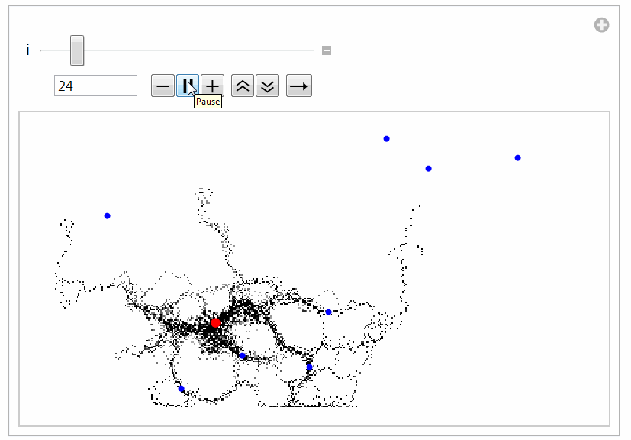
Global Search
Generate multiple solutions.
Evolve by examining whole search space.
Typically based on natural processes.
Swarm patterns, foraging behavior, evolution.
Models of how populations interact and change.
Notes:
Global searches are pretty similar conceptually, but with a couple of differences. You still form solutions, score them, then improve them. The first key difference, though, is that global searches evolve populations of solutions in parallel instead of single solutions. Then, all of the global searches have a strategy in place to sample from the whole search space instead of strictly sitting in the local neighborhood of any one solution. They don’t just impose mutations, but may have other mechanisms for promoting and combining different solutions. They tend to be inspired by some natural process. The most famous, genetic algorithms, are based on how species evolve over time, with mechansims modeling mutation and breeding and how those influence the gene pool. Particle swarm optimization looks at how swarms of insects explore a space. Ant colony optimization is based on how ants forage for food and lead other ants to food that they have discovered so it can be brought back to a hive. In general, global searches tend to (last). Let’s go over the most famous of these, and most common, the genetic algorithm.

Slide 37

Genetic Algorithm
Over multiple generations, evolve a population.
Good solutions persist and reproduce.
Bad solutions are filtered out.
Diversity is introduced by:
Selecting the best solutions.
Creating “offspring” through mutation and crossover.
Notes:
Genetic Algorithms model the evolution of a population over time. In a population, certain individuals may be “fitter” than others, possessing traits that lead them to thrive—traits that we would like to see passed forward to the next
generation through reproduction with other fit individuals. Over time, random mutations introduced into the population may also introduce advantages that are also passed forward to the next generation. Over time, through mutation and
reproduction, the overall population will grow stronger and stronger. As a metaheuristic, a Genetic Algorithm is build on a core generation-based loop like the Hill Climber. However, there are two primary differences: As noted, Rather than evolving a single solution, we simultaneously manage a population of different solutions. Second, In addition to using mutation to improve solutions, a Genetic Algorithm also makes use of a selection process to identify the best individuals in a population, and a crossover process that produces new solutions merging the test cases (“genes”) of parent solutions (“chromsomes”).

Slide 38
Genetic Algorithm
Create a random initial population.
Start a new generation (while budget remains):
Create new empty population.
While space remains:
Select two “good” members of current population.
At a small probability, replace these members with “children” combining genes of members (crossover).
At a small probability, mutate each member.
Add members to new population.
If no better solution is found for N generations, terminate early (stagnation).
Notes:
The core algorithm is outlined here. We start by creating an initial population, where each member of the population is a randomly-generated test suite. We then begin the first generation
of evolution.Each generation, we form a new population by applying a series of actions intended to promote the best “genes” forward. We form the new population by creating two new solutions at a time. First, we attempt to identify two of the best solutions in a population, a process called selection. These two solutions may be carried forward as-is. However, at certain probabilities, we may make further modifications to the chosen solutions. The first of these is crossover—a transformation that models reproduction where we combine individual genes (test cases) of the two solutions. We may introduce further mutations to zero, one, or both of the solutions. At a certain probability, we will introduce a single mutation to each solution. We do this independently for both. The mutation process is the same as in the Hill Climber, where we can add, delete, or modify an individual action or add or delete a full test case. Finally, we add both of the solutions to the new population. If either solution is better than the best seen to date, we save it to be returned at the end of the process. Once the new population is complete, we continue to the next generation. There may be a finite amount of improvement that we can see in a population before it becomes stagnant. If the population cannot be improved further, we may wish to terminate early and not waste computational effort. To enable this, we count the number of generations where no improvement has been seen, and terminate if it passes a user-set exhaustion threshold. If we identify a new “best” solution, we reset this counter .

Slide 39
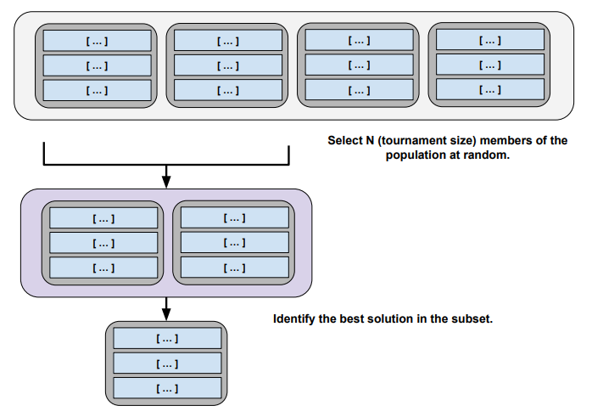
Selection
Rather than searching for best population member:
Select a random subset.
Calculate fitness for each.
Return best.
Notes:
If the population is large, identifying the best members can be an expensive process. To reduce this cost, each time we select two solutions from the current population, we perform a selection procedure on a randomly-chosen subset of the population). The fitness of the members of the chosen subset is compared in a process called “tournament”, and a winner is selected. The winner may not be the best member of the full population, but will be at least somewhat effective, and will be identified at a lower cost than comparing all population members. We also store the score with each population member, so we don’t need to recalculate it if it is selected again.

Slide 40
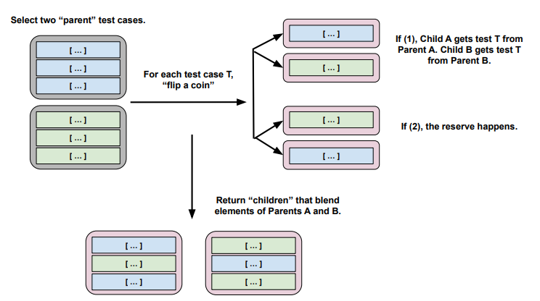
Crossover
Creates two “child” solutions by combining tests from each parent solution.
Notes:
In crossover, we combine individual genes (test cases) of the two selected solutions using the following process: (go over image) If the parents do not contain the same number of test cases, then the remaining cases can be randomly distributed between the children.

Slide 41
Genetic Algorithm Parameters
All parameters affect solution quality. Usually some experimentation required.
Population Size (default: 20)
Tournament Size (# population members compared during selection, default: 6)
Crossover Probability (default: 0.7)
Mutation Probability (default: 0.7)
Stagnation Threshold (# generations without improvement before ending, default: 30)
Notes:
The following parameters of the genetic algorithm can be adjusted: • Population Size: The size of the population of solutions. By default, we set this to 20. This size must be a even
number in the example implementation. • Tournament Size: The size of the random population subset compared to identify the fittest population members. By default, this is set to 6. • Crossover Probability: The probability that we apply crossover to generate child solutions. By default, 0.7. • Mutation Probability: The probability that we apply mutation to manipulate a solution. By default, 0.7. • Exhaustion Threshold: The number of generations of stagnation allowed before the search is terminated early. By default, we have set this to 30 generations. These parameters can have a noticeable effect on the quality of the solutions located. Getting the best solutions quickly may require some experimentation. However, even at default values, this can be a highly effective method of generating test suites

Slide 42
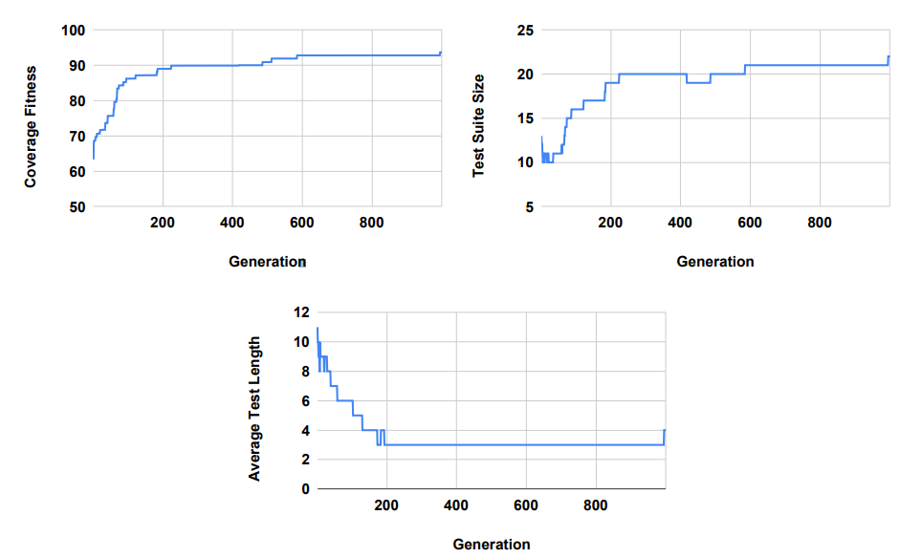
1000 Generations of Evolution
Genetic Algorithm run for 1000 generations for BMICalc.
Stagnation turned off.
Highly variable until ~ 200 generations, then small changes afterwards.
Notes:
Now that we have all of the required components in place, we can generate test suites and examine the results. To illustrate what these results look like, we will generated test suites for the BMI Calc example using the Genetic Algorithm for 1000 generations. During these executions, we disabled the exhaustion threshold to see what would happen if the algorithm was given the full search budget to work. illustrates the results of executing the Genetic Algorithm. We can see the change in fitness over time, as well as the change in the number of test cases in the suite and the average number of actions in test cases. Note that fitness is penalised by the bloat penalty, so the actual statement coverage is higher than the final fitness value. The fitness starts around 63, but quickly climbs until around generation 100, when it hits approximately 86. At generation 717, it hits a fitness value of 92.79, where it remains until near the very end of the execution. At generation 995, a small improvement is found that leads to the coverage of additional code and a fitness increase to 93.67. The test suite size starts at 13 tests, then sheds excess tests for a quick gain in fitness. However, after that, the number of tests rises slowly as coverage increases. For much of the search, the test suite remains around 20 test cases, then 21. At the end, the final suite has 22 test cases. At times, redundant test cases are removed, but instead, we often see redundancy removed through the deletion of actions within individual test cases. The initial test cases are often quite long, with many redundant function calls. Initially, tests have an average of 11 actions. Initially, the number of actions oscillates quite a bit between an average of 8-10 actions. However, over time, the redundant actions are trimmed from test cases. After generation 200, test cases have an average of only three actions until generation 995, when the new test case increases the average length to four actions. We see that the tendency is to produce a large number of very small test cases. This is good, as short test cases are often easier to understand and make it easier to debug the code to find faults.

Slide 43
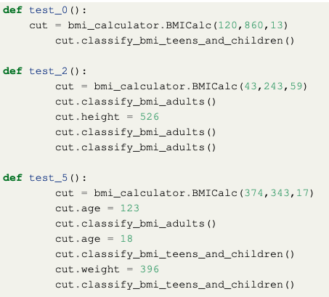
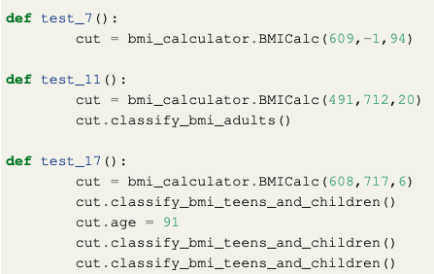
Examples of Generated Test Cases
Notes:
We can look at a few of the 22ish tests generated here. Some test cases look like test_0() and test_11() in the example—a constructor call, followed by a BMI classification. Others will adjust the variable assignments, then make calls. For example, test_5() covers several paths in the code by making assignments, then getting classifications, multiple times. test_7() is an example of one where only a constructor call was needed, as the value supplied—a negative weight, in this case—was sufficient
to trigger an exception. There is still some room for improvement in these test cases. For example, test_2() and test_17() both contain redundant calls to a classification method. It is likely that a longer search budget would remove these calls. It would be simple to simply remove all cases where a method is called twice in a row with the same arguments from the suite. However, in other cases, those calls may have different results (e.g., if class state was modified by the calls), and you would want to leave them in place.

Slide 44

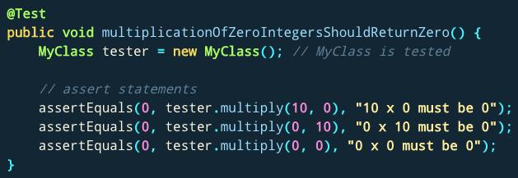
What Do I Do With These Inputs?
If looking for crashes, just run generated input.
If you need to judge correctness, add assertions.
Suggested: general properties, rather than specific expected output.
No: assertEquals(output, 2)
Yes: assertTrue(output % 2 == 0)
Notes:
(title)These test cases lack assertion statements, which are needed to check the correctness of the program behavior. If you’re just looking for crashes or exceptions, you’re done! run them, see if something breaks. You see if something crashes, if there is a memory leak, if there is a buffer overflow, and if any of those happen, there is a problem. Now, sometime you still need something more complicated, something to judge correctness if the test passes. In those cases, you need to add assertions still. Good advice here is not to develop assertions that check for exact values. Instead, if you develop assertions as universal properties (not specific output expected), can apply those to all tests. So, rather than an assertion that says that the outcome if 4 if the input is 2, instead, an assertion that the outcome will be a positive, even number. Something that can be applied either universally or across a wide range of test input.

Slide 45
I Want to Try This Out!
Python:
Tutorial for beginners: https://greg4cr.github.io/pdf/21ai4se.pdf
https://github.com/Greg4cr/PythonUnitTestGeneration
EvoSuite for Java: http://www.evosuite.org/

Slide 46
I Want to Try This Out!
Fuzzing often based on metaheuristic search.
AFL (American Fuzzy Lop), Google OSS-Fuzz use genetic algorithms, fitness = code coverage.
http://lcamtuf.coredump.cx/afl/
https://google.github.io/oss-fuz
system-level tests
The Fuzzing Book has tutorials and code for many specialized approaches:
https://www.fuzzingbook.org/

Slide 47
Large Language Models

Slide 48
Large Language Models
Translation
Model
Prompt
Source Code
Answer to Question
Notes:
A large language model is a machine learning model that produces new text content in response to instructions delivered in the form of a prompt. Models are trained to infer the semantic meaning of a prompt, and use that meaning to produce an appropriate response. Current models generally are implemented using a transformer-based architecture, which is based on attention mechanisms designed to imitate the cognitive attention (i.e., the ability to focus on select stimuli) seen in humans. LLMs are suited for language analysis and transformation tasks such as translation, summarization, and decision support due to their ability to infer semantic meaning from textual input, based on how words are generally used together in the text in the training set. LLMs generate output by iteratively predicting the next token or word in the generated sequence. Because of their ability to understand and output both natural language and code, LLMs are well-suited for software development tasks including test generation, automated program repair, and code review.

Slide 49
Large Language Models
Model
“The server brought me the bill”
for my three-course dinner.
Encoder
Decoder
“We sent an HTTP request to the server”
to update the database record.
Notes:
How this works is based on a statistical model of how certain words are used together. The input to the model is transformed from raw text into a numerical representation, generally a vector or a network structure. This is done using an encoder. The model then processes this encoded structure, and iteratively predicts the appropriate response, what is statistically likely to be the next token to follow the input or the previous token. A token is generally a word. It will do this until the next likely token is the end of the response, or up to a certain length. Once the response is calculated, it will be transformed back into text, using a decoder, and returned to the user. For example, consider the sentence, “The server brought me the bill.” versus “We sent an HTTP request to the server”. Both of those sentences are kind of similar, both have the word server, but the word is *likely* being used in different ways. In the first case, the server is likely in a restaurant and brining you the bill for the meal. In the second, we are talking about a computer sitting in a remote data center. The next sentence will be very different in those cases. The LLM, based on its training data, will infer that context from the surrounding words and past examples from its training data. In the first case, “brought” implies a physical presence, a “bill” is common in a restaurant. In the second, “HTTP request” might imply a REST API call, distinguishing it from the restaurant example. Of course, if we left the HTTP part out, there would be less context to work with, which might lower the confidence in the calculated response and introduce more risk of the wrong answer. When choosing a model to work with, some models only perform the calculation and decoding, and you must choose a separate encoder model to do the initial transformation. However, most newer LLMs, like GPT4, DeepSeek, or Llama, are combined encoder-decoder models that perform the full task.

Slide 50
Important Considerations
Prompt Design
The structure and information provided in the prompt.
Model Selection
Type of model.
Closed vs open source.
Local vs remote execution.
Notes:
The important thing to keep in mind when working with LLMs is that they look a bit magical. They look like they are thinking, like they are intelligent. They aren’t. Keep that in mind. These are fancy parrots - a complex form of autocomplete. They are just predicting the highest probability response, based on information seen in the past. They cannot do anything purely on their own. To get good results from an LLM, there are two important aspects to consider. The first and most important is how you prompt them. The information presented in the prompt is what will determine the result. So, we will talk thorough techniques for the design of prompts, “prompt engineering”. How is the prompt written, what information is included. The second consideration is your selection of a model to use. This includes the type of model, its past performance on similar problems, whether you use a closed or open source model, and whether you execute the model locally or pay a provider for access.

Slide 51
Prompt Engineering
General: More information, more specific results.
“Generate pytest unit tests for a method that calculates the BMI of an adult.”
“Generate pytest unit tests for method bmi_value(self) in class BMICalc. This class has three variables: height, weight, and age.”
“Generate pytest unit tests for the following method in class BMICalc. This class has three variables: height, weight, and age. def bmi_value(self): # The height is stored as an integer in cm. Here we convert it to # meters (m) bmi_value = self.weight / ((self.height / 100.0) ** 2) return bmi_value”
Notes:
Try each prompt in copilot, go over results
(1-2) Makes up an implementation, unlikely to match exactly what we’re going to test. Still has seen enough past examples to come up with some interesting test cases, but will need to work to adapt it.
(3) Makes up implementation, but the method signature and general idea is ok. In our actual class, we have the checks for 0 height and 0 weight elsewhere. Interestingly, it only checks for 0 height here because of the potential division by zero, but not 0 weight which should be impossible, but won’t give a runtime error. The tests are exactly the same, but the format is better for our code.
(4) In this case, same test cases, but better for our actual code. Still missing some information on how we handle the 0 and negative values for height and weight. So, let’s do one more where we give it more to work with.

Slide 52
Prompt Engineering
General: More information, more specific results.
“Generate pytest unit tests for the class BMICalc. This class has three variables: height, weight, and age. It offers setter methods height(self, height), age(self, age), and weight(self, weight). These methods check for negative values. The class also offers the following methods: bmi_value(self), classify_bmi_teens_and_children(self), and classify_bmi_adults(self)”
Generally a limit to the prompt length, but can potentially provide a full class to test (or at least full code of some of the methods).
“Generate pytest unit tests for the following class: (code)”
Notes:
(2) Now, you can see that it adds some test cases, but it still clearly missing enough detail on how the code works. It doesn’t really get the classification logic. So, to get useful tests, we still need more information.
Now, you can also expand on this further by providing code for some or all of the methods. Keep in mind, there is a limit to the prompt length, so you can’t always provide the full code, but you can provide some or potentially all of the methods. So, one more, where we provide the full classification code. (4) These are much better than the previous prompts. However, you can still see that these don’t give you a lot of coverage of the code. These do have assertions, which is nice compared to the search-based approach, but the search-based approach had more coverage of the code in not many more test cases (15 vs 20). We can ask for more tests, and we can ask for tests on specific aspects, but we need to think to ask for them. That’s not bad, but something to keep in mind is that this is an iterative process. Maybe not one pass and done.

Slide 53
Additional Prompting Concepts
Can include examples of human-written tests:
Zero-Shot: No examples provided.
One-Shot: One example test provided.
Few-Shot: Multiple examples provided.
Chain of Thought: Include rationale with the example(s).
Role: Instruct the LLM to take on a role. This can help bias towards particular training examples.
Notes:
go over

Slide 54
Additional Prompting Concepts
“You are an experienced software tester. Generate pytest unit tests for the following code: (code) Here are two examples of test cases, with explanation: (test 1, explanation) (test 2, explanation)”
Notes:
Here is what that might look like. In the BMI case, it doesn’t really help us much - it just expands the classification tests but copies the examples. However, it other cases, it can help produce better tests or tests more likely to compile.

Slide 55
Choosing an LLM
Type of model:
Instruction: Tuned for following directions and returning results in a specified format.
Chat: Tuned for conversations with a user (e.g., Q&A).
Size (number of parameters)
More generally yields better results, but much higher computational cost.
Notes:
The second core consideration is how to choose an LLM for a task. The first aspect to consider is the type of model. There are usually variants of different LLMs tuned towards certain types of tasks. The two main ones to be aware of are instruct models and chat models. Instruct models (2), while chat (3). For test generation, you generally want to use an instruct model, unless you have a use case where the tester is engaged in a back and forth conversation with the LLM about the test cases. Then, you may want a chat model. The second aspect is the size of the model. Many models have variants of different sizes, measured in the number of parameters. More is generally better. High parameter models offer a better basic level of performance on many tasks, though there may be diminishing returns. However, the trade off is the computational cost. Larger models are much more expensive. If you are running models locally, you need very powerful hardware -especially GPU resources - to execute larger models. Even if you are executing models remotely, e.g., using Microsoft or OpenAI’s cloud platforms, the larger models cost more money because of the computational cost.

Slide 56
Choosing an LLM
Open Source: Creators disclose contents of the training data and how the model was tuned.
MapNEO, OLMo
Open Weight: Creators disclose how model was tuned, but not training data.
DeepSeek, Llama, Mistral
Closed Source: Neither data or weights disclosed.
OpenAI models
Notes:
(go over). Using open source and open weight models can offer more unstandability of the results, better ability to analyze where a result came from. It can resolve concerns over copyright - you can more easily see if you are copying code that belongs to someone else without permission. Gives greater repeatability in the results - you know what specific version of a model you are using. If you use a OpenAI model, they can change it behind the scenes without telling you, which means hat you might get very different results in the future without any explanation of why. The trade off tends to be in performance. The closed source models may be better because there is a commercial interest, just without any visibility.

Slide 57
Choosing an LLM
Local execution: Model deployed locally.
Remote execution: Model executed via API on servers owned by model creator.
Consider costs of both options.
License/access vs hardware requirements
Data privacy concerns with remote execution.
OpenAI stores and uses your input data unless you pay for a corporate license.
Notes:
(1-2) If considering a model deployed by an external company, the cost of a license and limitations on the number of API calls must be considered [73]. In addition, there may be significant data privacy concerns, related to sending proprietary or customer-related data to a third party [114]. If an organization can afford the computational costs of an internal deployment, then that is generally a better option. Internal deployment avoids privacy concerns [114], and offer greater control over the deployment. For example, the organization can tune such models, can change their parameter settings, and can choose when and how to deploy updated models—these aspects are not always controllable when the models are controlled by an external firm [114].

Slide 58
Comparing Approaches
Notes:
We’ve now presented these two approaches, search-based generation and LLM-based generation. Let’s compare them a little and talk about the advantages and disadvantages of each

Slide 59
Search-Based Test Generation
Advantages:
Does not require knowledge of the code.
Do not need similar training data.
Can be implemented for any system, language, platform.
Can be parallelized and is computationally efficient.

Slide 60
Search-Based Test Generation
Disadvantages:
Lacks knowledge of the code.
Random selection of input - “blind guessing”
Improving coverage requires being guided to the right input.
Tests are hard to understand.
Input and method sequences that a human may not pick.
Limited “rationale” for test case purpose.

Slide 61
LLM-Based Test Generation
Advantages:
Can infer how the code works.
(as long as there is similar training data)
Can be more coverage of program outcomes/behaviors.
Tests closer to what a human would produce.
Each test has a single purpose.
Understandable input and method sequences.
Can generate documentation and assertions.
More complete test cases.
Notes:
almost exactly the opposite

Slide 62
LLM-Based Test Generation
Disadvantages:
Inferences from code may be incorrect.
Code may not compile.
Code may contain hallucinated functionality/methods.
Tests may not correspond to actual implementation, just similar training examples.
Tests may assume faulty code is correct.
Tests may achieve limited coverage.
Limited ability to generate tests that expose performance/quality issues.
Notes:
almost exactly the opposite. LLMs do not actually run the code. So…

Slide 63
Summary
Search-Based Test Generation
Test creation as an optimization problem, based on feedback from executing the code.
Generate -> Execute -> Evolve
LLM-Based Test Generation
Test creation based on textual analysis.
Notes:
So, both approaches have their strengths and weaknesses, and in fact, complement each other to a great extent. One could apply both to a project, and in the near future, I imagine you will see more combined approaches that unify these - researchers are starting to experiment with such combinations. To wrap up (go oveR)

Slide 64
Next Time
Course summary and exam review
Try the practice test!
Assignment 4 - Due March 14

